Slide 1
Web Accessibility Test Tools
A Hackweek XIII - Project #33
Presented by Khai Pham

Slide 2
About Web Accessibility
Web accessibility means that websites, web tools, and technologies are designed and developed in a way that people with disabilities can use them.
It’s important for businesses, Brightcove customers, to ensure web accessibility, compliant within both Section 508 laws and the adopted standards of WCAG 2.0
To learn more about Web Accessibility: https://www.w3.org/WAI/
Notes:
Section 508 law applies to Federal government agencies with many States have followed.

Slide 3
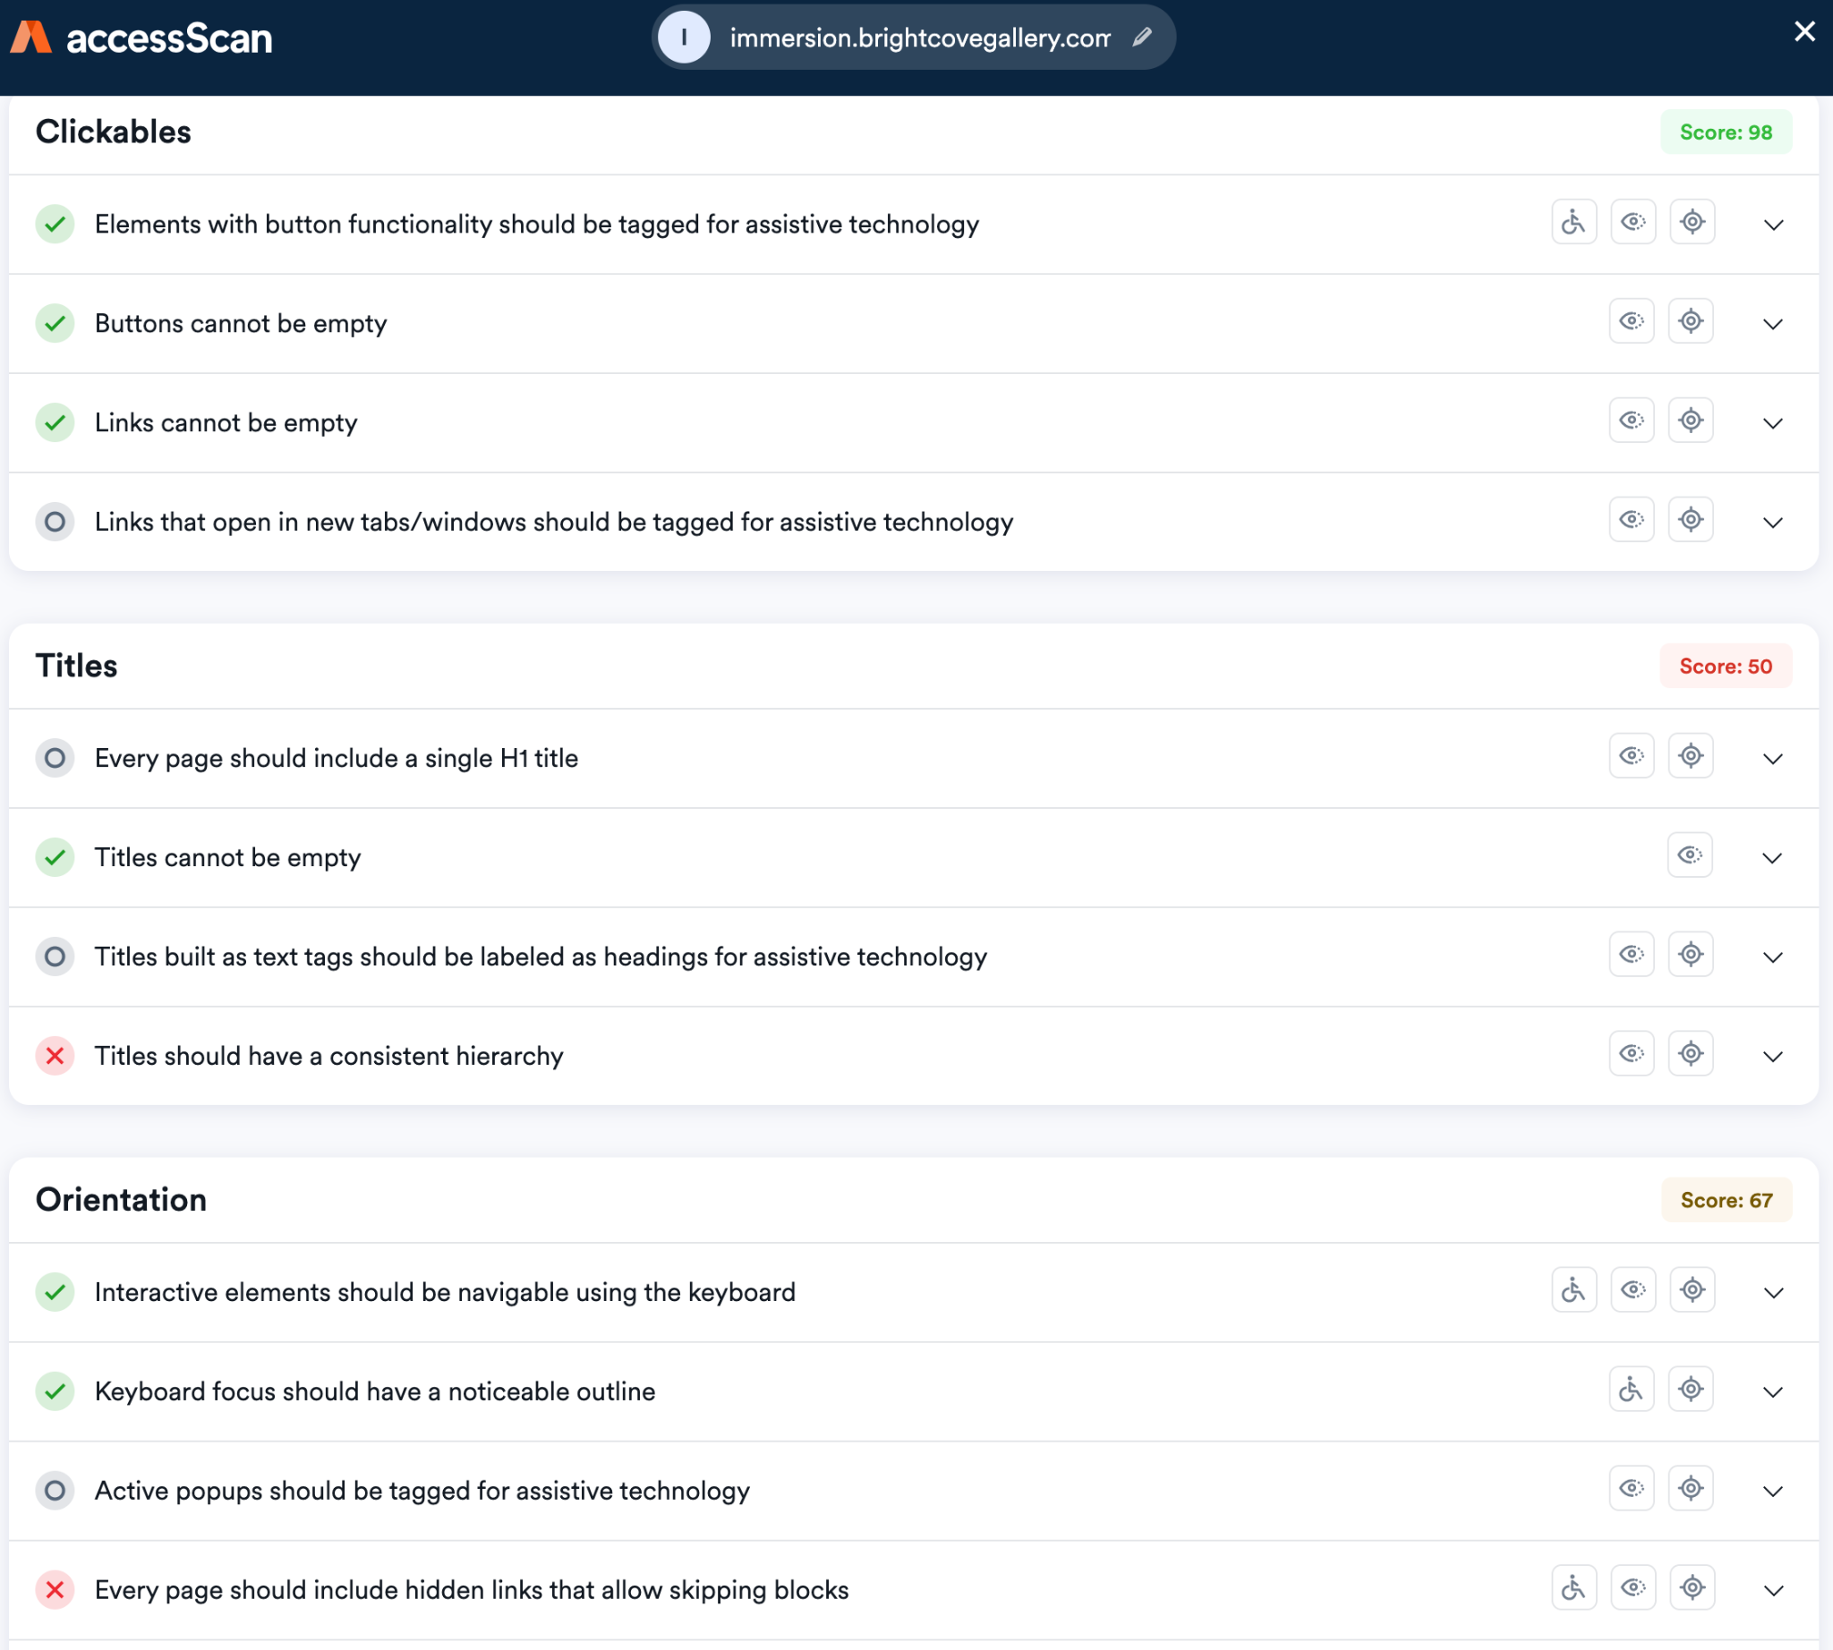
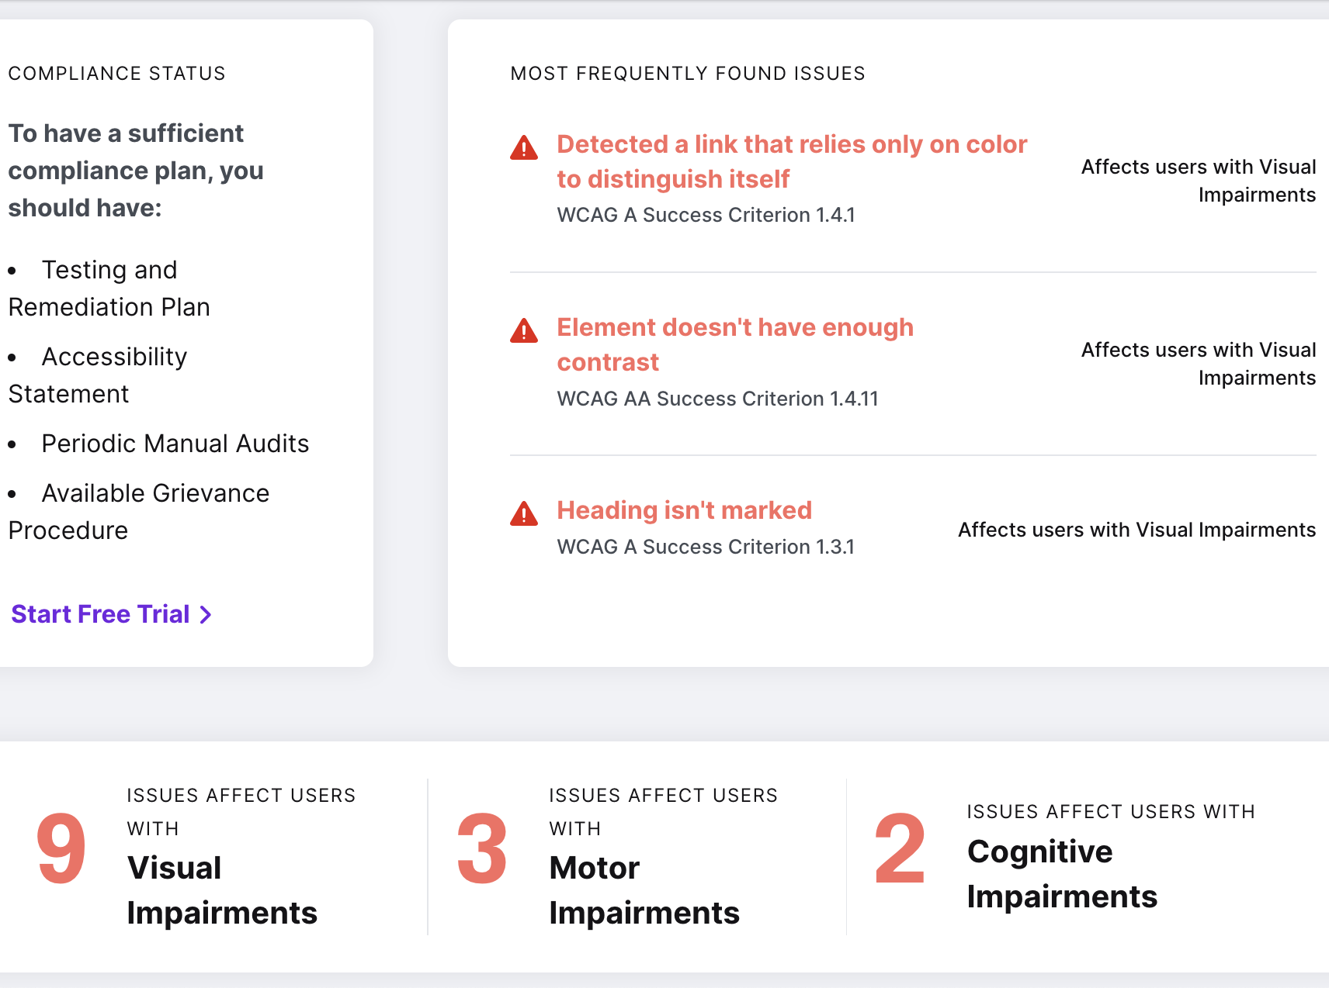
Web Accessibility - Online websites checkers
Notes:
Anyone can use. Limited to publicly available websites. Free version is limited in functionality.

Slide 4
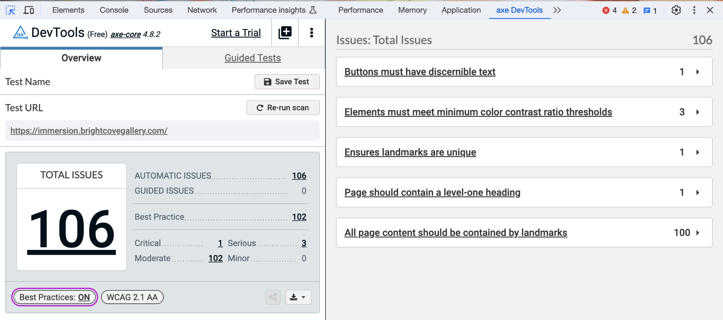
Web Accessibility - Chrome browser extensions
Notes:
Works with local websites, web application, as long as Chrome browser loads it.
Reported Issue can be traced to visual element.

Slide 5
Web Accessibility Testing Tools - DEMOs
Website scanners
Axe DevTools
Axe DevTools
https://accessibe.com/accessscan?website=http://immersion.brightcovegallery.com
https://www.audioeye.com/scan/results/?url=https://immersion.brightcovegallery.com
https://chrome.google.com/webstore/detail/axe-devtools-web-accessib/lhdoppojpmngadmnindnejefpokejbdd
Notes:
testcafe chrome test/a11y_test.js --skip-js-errors --violationThreshold=1
testcafe chrome suites/accessibility --siteUrl=http://immersion.brightcovegallery.com
testcafe chrome suites/portal/end2end/immersion_test.js --violationThreshold=1
For now, automated accessibility tests are designed to pass by default violationThresdhold, only reporting number of violations

Slide 6
Web Accessibility - Tools for test automation
axe-core - deque’s accessibility testing engine for test automation
@khaipham/axe-testcafe - allow latest aXe accessibility engine to be used in TestCafe tests
@brightcove/studio-testcafe-common - (another hackweek project started 4 years ago)
added a11yCheck() function - accessibility check with error Threshold
@brightcove/gallery-automation - (recently refactored into npm package)
use studio-testcafe-common a11yCheck() in portal helper function validate_accessibility()
suites/accessibility - accessibility tests with command line parameters for Url & Threshold
Notes:
Npm packages that can be used in any repo; validate_accessibility() utilize a11yCheck() with viewports, which utilize axeCheck() with violationThreshold

Slide 7
Web Accessibility Testing Tools - DEMOs
Studio-testcafe-common
A11y tests
gallery-
Automation
A11y tests
testcafe chrome test/a11y_test.js --skip-js-errors --violationThreshold=1
testcafe chrome suites/accessibility --siteUrl=http://immersion.brightcovegallery.com
testcafe chrome suites/portal/end2end/immersion_test.js --violationThreshold=1
Notes:
testcafe chrome test/a11y_test.js --skip-js-errors --violationThreshold=1
testcafe chrome suites/accessibility --siteUrl=http://immersion.brightcovegallery.com
testcafe chrome suites/portal/end2end/immersion_test.js --violationThreshold=1
For now, automated accessibility tests are designed to pass by default violationThresdhold, only reporting number of violations

Slide 8
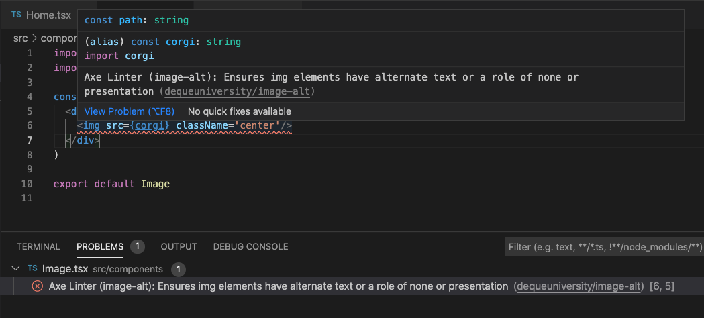
Web Accessibility - axe Accessibility Linter for VS Code
Notes:
Proactive tool for developers writing web application code

Slide 9


Web Accessibility Test Tools
Test automation repos for code reviews and utilizing:
https://bithub.brightcove.com/videocloud/studio-testcafe-common
https://bithub.brightcove.com/gallery/gallery-automation
Questions & Comments:
@kpham
kpham@brightcove.com

